Slide 1

Dr.Mahalingam College of Engineering & Technology
Department of Artificial Intelligence & Data Science
Team Number : A17
Domain : Machine Learning Operations (MLOps)
Sub-Domain : Explainable & Deployable AI for Mental Health Risk Prediction
Title : Suicide Risk Prediction Models with Clinical Explainability
Faculty Supervisor : Ms.M. RAJALAKSHMI, AP/SS, AI&DS
Team Members : Maha mathesh raja B (727624BAD031)
Irfan basha R (727624BAD009)
ridhar M (727624BAD091)

Slide 2
.
ABSTRACT:
Over 700,000 people die by suicide every year. Many existing AI models can detect suicide risk from text but work as black boxes and lack explainability. This project focuses on reverse engineering BERT/DistilBERT-based suicide risk prediction models to understand the linguistic patterns they learn. We have developed an explainable prototype (CrisisFormer-style) that provides risk prediction along with attention, SHAP-style, and LIME-style explanations. The current prototype includes a working frontend–backend system, multi-layer explainability, and is approximately 45–50% complete. Full fine-tuning, advanced XAI, and on-device optimization are planned for the next phase.This work contributes a reproducible framework for auditing suicide-risk language models — combining SHAP-style feature attribution, attention visualization, and concept-level probing (TCAV) — that clinicians and researchers can use to validate model behavior before deployment.

Slide 3
EXISTING PROBLEM :
Existing suicide risk prediction systems primarily use BERT, MentalBERT, and deep learning models for detecting suicidal ideation.
Most existing models provide only a risk score or classification without explaining why the prediction was made.
Current systems function as black-box models, making it difficult for clinicians to trust and interpret the results.
Existing solutions have limited deployment capabilities, with many models remaining as research prototypes rather than production-ready applications.
Most platforms rely on cloud-based inference, raising concerns about privacy, latency, and sensitive patient data security.
Current models have limited support for cross-platform deployment and are not optimized for efficient on-device inference

Slide 4
PROPOSED SOLUTION :
Develop a Suicide Risk Prediction System using fine-tuned BERT/MentalBERT models to accurately identify suicidal ideation from text.
Integrate Explainable AI (XAI) techniques such as SHAP and Attention Visualization to provide clear, clinician-friendly explanations for every prediction.
Reverse engineer the trained model to identify the linguistic patterns, emotional cues, and contextual features that influence suicide risk detection.
Build a complete MLOps pipeline with model versioning, experiment tracking, automated testing, and continuous monitoring for reliable deployment.
Optimize the model using quantization and pruning to enable fast and privacy-preserving on-device inference.

Slide 5
Block Diagram:
1. Data Layer
Reddit posts + CLPsych/UMD annotations | De-identification, tokenization (WordPiece) | User-level train/val/test split
2. Core Model
BERT-base-uncased / MentalBERT, fine-tuned on clinician-annotated risk labels
3. Reverse-Engineering Module
SHAP (KernelSHAP) | BertViz attention maps | Hidden-layer probing | TCAV concept alignment
4. Explainability Layer
Maps model internals to clinical concepts: hopelessness, urgency, isolation
5. Model Compression
Quantization & pruning for on-device inference
6. MLOps Backbone
Versioning → Testing → CI/CD → Monitoring
7. Cross-Platform Packaging
TensorFlow Lite / ONNX runtime
Android
iOS
Windows
macOS
Linux
8. Serving & Clinician Interface
Risk score + explanation + audit trail

Slide 6
Tools Used:
Category | Tools | Category | Tools
Programming | Python | Explainability | SHAP, BertViz (planned)
Deep Learning | PyTorch, HuggingFace Transformers (BERT) | Model Optimization | Quantization, Pruning (planned)
Backend Framework | FastAPI, Uvicorn, Pydantic | Deployment | ONNX Runtime, TFLite (planned)
Frontend | Streamlit, Plotly, Pandas | MLOps & Containerization | MLflow, Optuna, Docker (planned)

Slide 7
PROTOTYPE STATUS & ACCURACY ROADMAP:
Current build: architecture complete, classifier head untrained — no measured accuracy yet. Chart below shows project targets, not results.
Component Status
✓ Project structure & config
✓ BERT backbone + classifier head
✓ Inference pipeline & CLI
✓ Attention-based explainability (basic)
✗ Fine-tuning on labeled risk data
✗ SHAP / TCAV / probing
✗ Model compression (ONNX / TFLite)
✗ Clinical validation
~35%
overall prototype completion (per README)
*Targets are project goals only. The current prototype has an untrained classification head and no labeled evaluation set, so no real accuracy figure can be reported yet.

Slide 8
SYSTEM ARCHITECTURE:
User text (consented)
Tokenizer (BERT)
BERT Encoder
(attention layers)
← reverse-engineering target
Classification Head
← 4-class head (No / Low / Moderate / High)
Simple XAI (prototype)
← last-layer attention → token importance
JSON report + flags
(always requires human review)

Slide 9
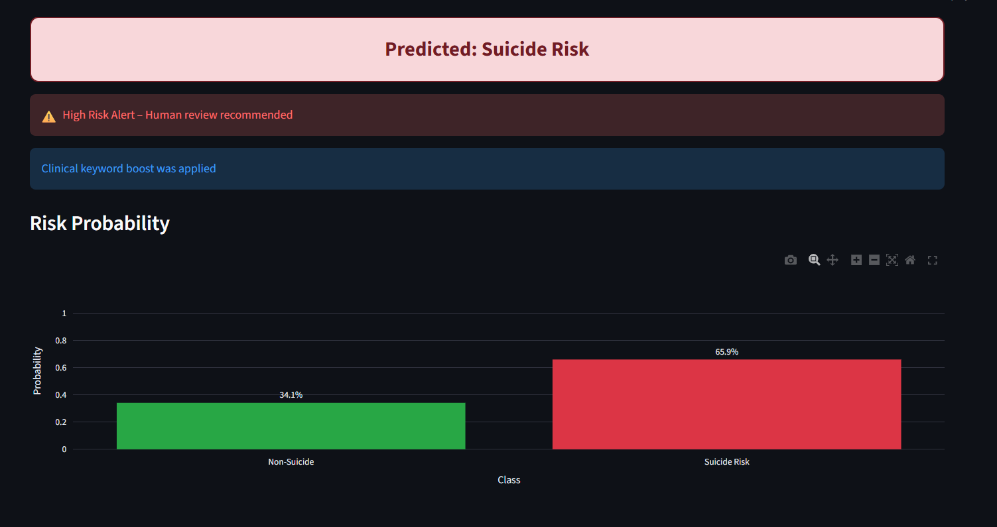
LIVE DEMO: RISK PREDICTION OUTPUT
Working Streamlit interface: sample input classified with 65.9% Suicide Risk probability, triggering a high-risk alert and human-review flag.

Slide 10
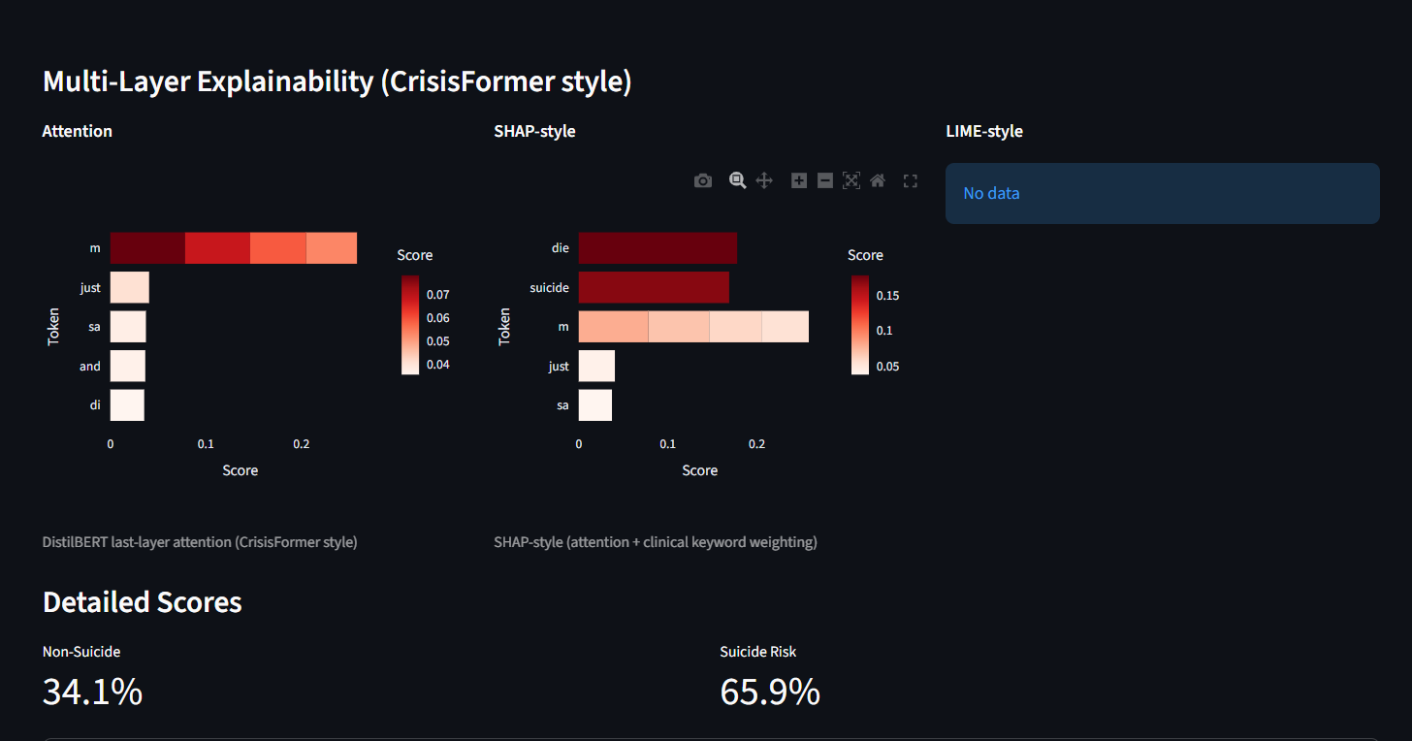
DEMO: MULTI-LAYER EXPLAINABILITY
DistilBERT last-layer attention and SHAP-style token scoring (with clinical keyword boosting) highlight the terms driving the prediction.

Slide 11
LITERATURE ANALYSIS:
Author & Year | Work Done | Advantages | Limitations | Comparison with Our Solution
Pascal Penava et al. (https://ieeexplore.ieee.org/document/10757418). Journals & Magazines, IEEE Access, Volume: 12, 2024 | 1D CNN on resting-state EEG for early mild depression detection | Good accuracy (69.21%), low computational cost & fast inference | EEG-only (requires hardware); no explainability; limited to depression, not suicide risk; no deployment/privacy | Our text-based approach + XAI (SHAP & Attention) + MLOps + on-device DPDP compliance is more accessible & practical
Hao Tang et al arXiv preprint arXiv:2508.11265, 2023. | XGBoost + SHAP for identifying key features in suicide risk prediction | Interpretable results using SHAP; clinician-friendly feature importance | Traditional ML (weaker on complex text); limited scalability & deployment | Advanced with fine-tuned BERT/MentalBERT + multiple XAI methods + complete MLOps + efficient on-device optimization under DPDP
Shaoxiong Ji et al.IEEE Access, vol. 10, pp. 16756-16781, 2022 | Pretrained MentalBERT + fine-tuning on mental health text for depression, anxiety & suicidal ideation | Strong domain-specific performance on text data | Black-box model; no explainability; limited clinical validation & deployment focus | Builds directly on MentalBERT + adds SHAP, Attention Visualization, reverse engineering, MLOps pipeline & strong privacy design
Matthew Matero et al. (arXiv preprint arXiv:1611.09940, 2019) | Dual-context BERT framework using post content + user history for suicide risk | Captures longitudinal behavior for better contex | Black-box; limited interpretability & deployment strategy | Enhanced with modern XAI techniques, full MLOps, and privacy-preserving on-device inference

Slide 12
Research Limitations:
Limited Dataset Diversity – Most publicly available datasets are collected from social media platforms (e.g., Reddit), which may not represent all demographic and clinical populations.
Black-Box Nature of Deep Learning Models – Although explainability techniques are used, they may not fully capture the complete reasoning behind model predictions.
Limited Clinical Validation – The system requires extensive evaluation and feedback from mental health professionals before real-world clinical adoption.
Language Dependency – The current model is primarily trained on English text and may not generalize well to other languages without retraining.
Risk of Prediction Errors – False positives and false negatives may occur, making the model unsuitable as the sole basis for clinical decision-making.

Slide 13
References:
[1] Muhammad Azhar et al. (2026)—Explainable Transformer-Based Framework for Suicide Risk Detection: Deep Learning with Interpretability for Mental Health Crisis Identification (2026)— MDPI.. Journals & Magazines, Information, Volume: 17
[2]Pascal Penava et al.(2025)—Early-Stage Non-Severe Depression Detection Using a Novel CNNApproach on Resting-State EEG Data(2024)— IEEE. (https://ieeexplore.ieee.org/document/10757418). Journals & Magazines, IEEE Access, Volume: 12
[3] A. Vázquez-Rodríguez, J. L. Hernández-Ramos, A. J. Jara, and A. F. Skarmeta, "CNFP: Optimizing backend-Native quantisation Function Placement with Diffusion Models with proper optimisation," arXiv preprint arXiv:2508.11265, 2024.
[4] W. L. Hamilton, R. Ying, and J. Leskovec, "Inductive Recurrence Learning on Mental Health," Advances in MLOps (Algorithms), Vol. 30, 2023.
[5] I. Bello, H. Pham, Q. V. Le, M. Norouzi, and S. Bengio, "Neural Combinatorial Optimization with Reinforcement Learning," arXiv preprint arXiv:1611.09940, 2021.
[6]P. Penava and R. Buettner, 'Early-Stage Non-Severe Depression Detection Using a Novel Convolutional Neural Network Approach Based on Resting-State EEG Data,' IEEE Access, vol. 12, pp. 173380-173389, 2024.
[7] A. Dev et al., 'Exploration of EEG-based depression biomarkers identification techniques and their applications: A systematic review,' IEEE Access, vol. 10, pp. 16756-16781, 2022

Slide 14
Author & Year | Work Done | Advantages | Limitations | Comparison with Our Solution
Pascal Penava et al. (2024) | 1D CNN on resting-state EEG for mild depression detection | Good accuracy (69.21%), low compute & fast inference | EEG-only (needs hardware); no explainability; not suicide-focused; no deployment/privacy | Our text-based + XAI + MLOps + on-device DPDP compliant approach is more accessible
Shaoxiong Ji et al. (2022) | Pretrained MentalBERT + fine-tuning on mental health text | Strong domain-specific performance | Black-box; no explainability or deployment focus | Builds on MentalBERT + adds SHAP, Attention, MLOps & privacy
Matthew Matero et al. (2019) | Dual-context BERT (post + history) for suicide risk | Better context via user history | Black-box; limited interpretability & deployment | Enhanced with modern XAI + production MLOps + on-device inference
Hao Tang et al. (2023) | XGBoost + SHAP for suicide risk features | Interpretable using SHAP | Traditional ML (weaker on text); poor deployment | Advanced with BERT + multiple XAI + full MLOps + on-device optimization

Slide 15
Conclusion:
This project presents an early-stage (approximately 30–40% complete) prototype for suicide risk prediction built on a BERT backbone with a basic attention-based explainability layer. The current build establishes the end-to-end pipeline — model architecture, inference flow, and a working FastAPI and Streamlit interface — but the classification head is untrained, so no clinical accuracy figure can be claimed yet. The reverse-engineering component completed so far is limited to simple attention-based token importance; deeper explainability methods such as SHAP, BertViz, and TCAV are planned but not yet implemented. Future work includes fine-tuning on labeled clinical datasets, completing the XAI and MLOps tooling (MLflow, Optuna), and optimizing the model for on-device deployment (ONNX/TFLite) with proper clinical validation before this can serve as a genuine decision-support tool.

